Slide 1


Project name: Remote Thermal Viewing within High Voltage Subsystem: Web Interface
Erica Mathew

Slide 2

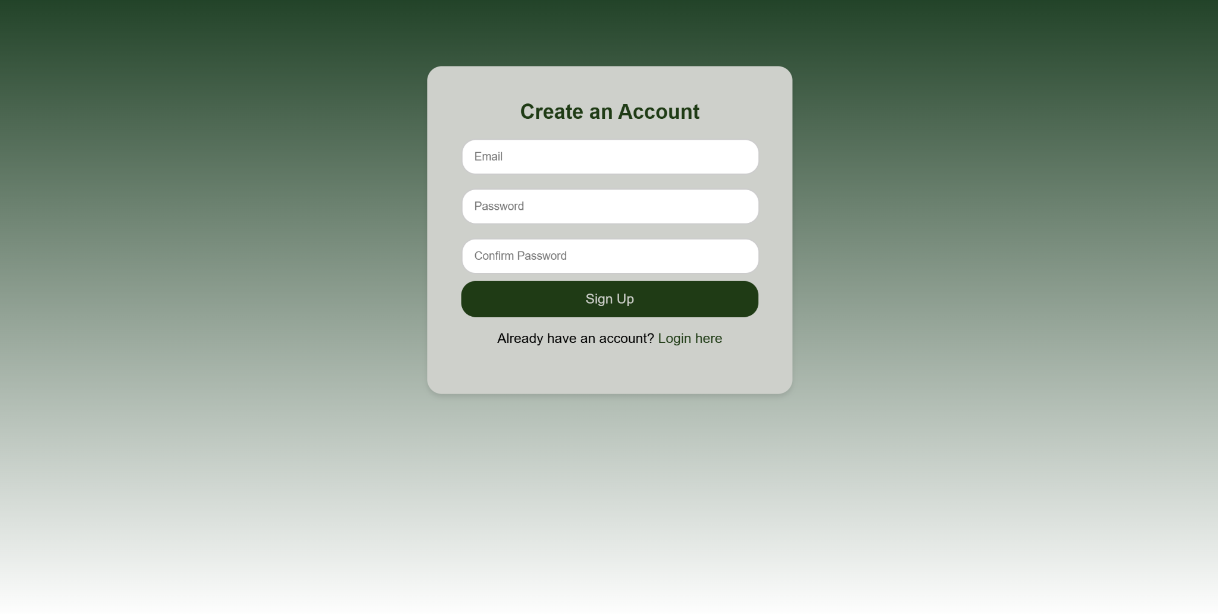
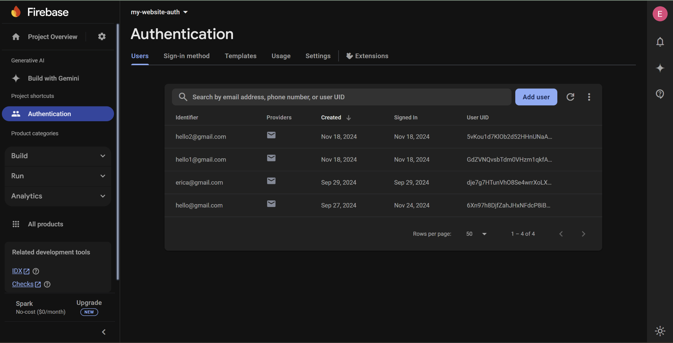
Login + Registration Pages
Login Page for users to log into existing profiles
Registration Page for users to create profile
FireBase Authentication allows users to create and store profiles in their database

Slide 3
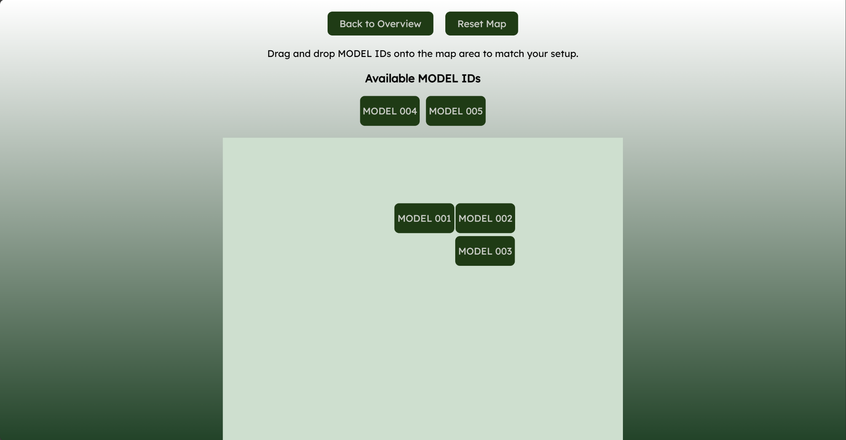
Map Builder
List of MODEL IDs represented as blocks
Use Interact.js to enable smooth drag/dropping between 2 dropzones (model-list and map-area)
Saves current layout to local storage
Layout is only cleared once when ‘reset’ button is clicked
Clicking on blocks 001 or 002 will direct user to video page of that specific MODEL ID passed as a URL parameter
Allows users to build a custom layout that matches their physical switchgear setup by dragging and dropping blocks that represent model ID. By clicking on a block it will direct the user to its specific video stream.

Slide 4
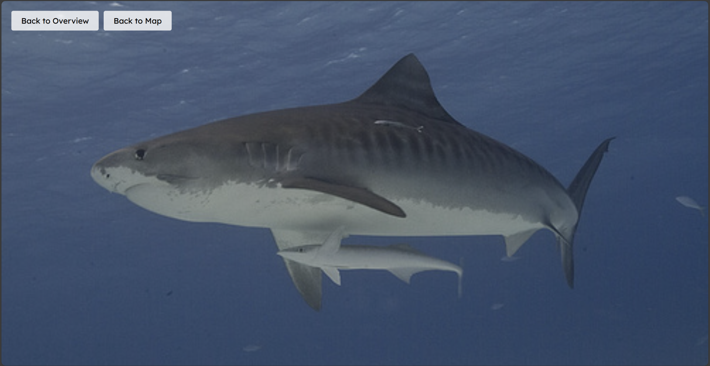
Video Streaming
Websocket Server
Server Server: Websocket server listens for client connection
Client: When client connects to server, the server checks URL to determine which stream it wants (001 or 002)
The server reads from folder of 1000 images
Server reads one image at a time and sends it as base64 encoded json object to client
Each new image replaces <img> element on website
Images are sent one at a time at a 1 second interval to mimic a video stream
Video Page dIsplays images one by one every second to mimic a video stream

Slide 5
Validation + 404 Integration
3.2.1.4 | Receiving Video | If no video stream is displayed on website, an error message should be outputted to screen. Video should be of correct vertical tower | Confirm the correct file is linked to its respective MODEL ID (either 001 or 002). 003-005 should display error message. | PASS | Erica Mathew
3.2.1.1 | Login-in System | Login with correct credentials and fail with incorrect credentials | Have user create different login credentials to check if they are stored in firebase | PASS | Erica Mathew
3.2.1.1 | Search Bar | Search bar redirects user to the proper video stream | Have user type different ID numbers to test search bar functionality | PASS | Erica Mathew
3.2.1.4 | Video Display Page | Overview Page that displays multiple video streams. Video streams in overview page are clickable to redirect user to zoomed in video feed on a different page | Send different video live streams and have user try to access all of them | PASS | Erica Mathew
After integrations with microcontroller:
Server Side:
Receives live images from microcontroller
Broadcast to client via websockets

